Slide 1
Arpeet Nandi
Melee Weapons
Health
Armor

Slide 2
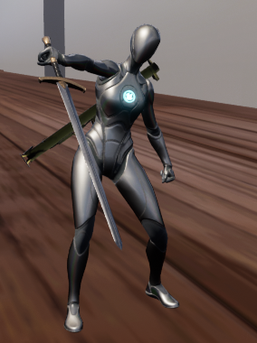
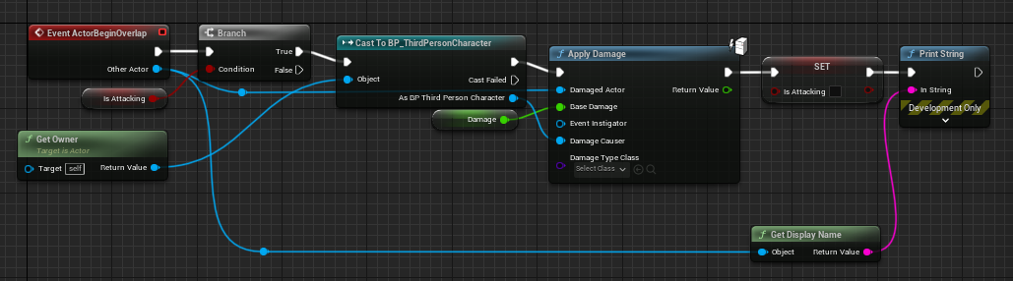
Melee weapons
The base MeleeWeapon2 class contains all important information about the weapon such as name, attack speed, damage.
All ranged weapons extend this class, which includes functionality for fighting and animations.

Slide 3
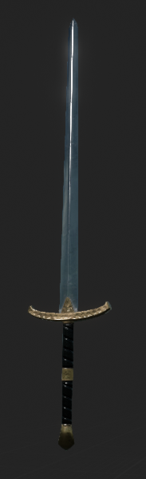
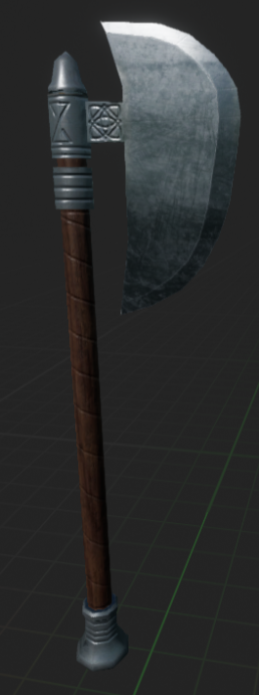
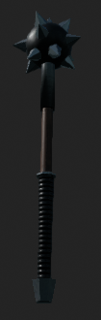
Melee Weapons
There are multiple different weapons, a sword, axe and mace, with different characteristics such as range and damage

Slide 4
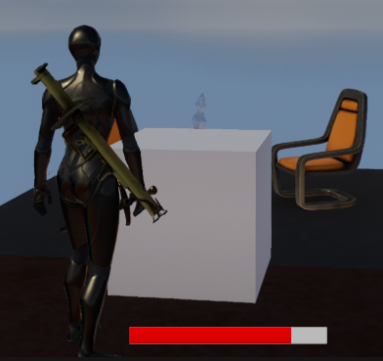
Health
An adaptive red Bar that represents the health of the player

Slide 5
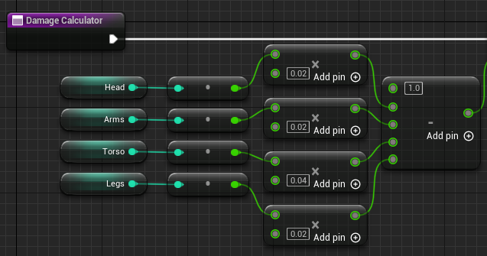
Armor
The damage percentage is
determined by the level of each
individual piece of armor and
based on that a certain
percentage of the damage taken is removed.

